Slide 1

SQL Project On PIZZA SALES
This Photo by Unknown Author is licensed under CC BY-SA

Slide 2
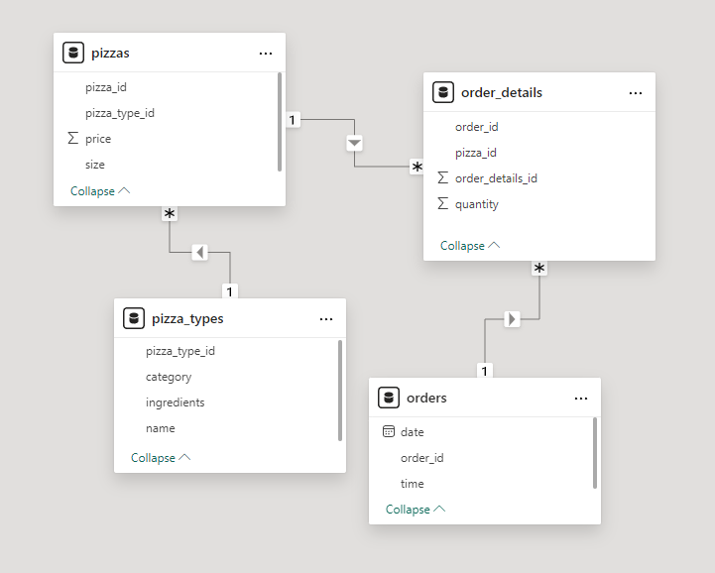
ERD Diagram:-

Slide 3
Question :-
Basic:
Retrieve the total number of orders placed.
Calculate the total revenue generated from pizza sales.
Identify the highest-priced pizza.
Identify the most common pizza size ordered.
List the top 5 most ordered pizza types along with their quantities.
Intermediate:
Join the necessary tables to find the total quantity of each pizza category ordered.
Determine the distribution of orders by hour of the day.
Join relevant tables to find the category-wise distribution of pizzas.
Group the orders by date and calculate the average number of pizzas ordered per day.
Determine the top 3 most ordered pizza types based on revenue.
Advanced:
Calculate the percentage contribution of each pizza type to total revenue.
Analyze the cumulative revenue generated over time.

Slide 4
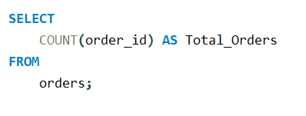
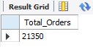
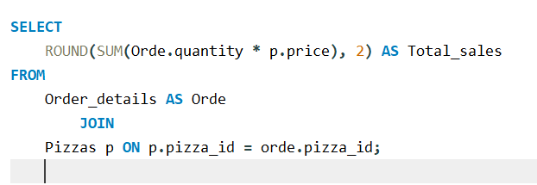
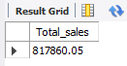
Retrieve the total number of orders placed.
Output
Calculate the total revenue generated from pizza sales.
Output

Slide 5
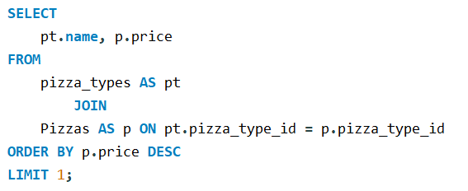
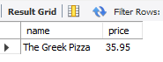
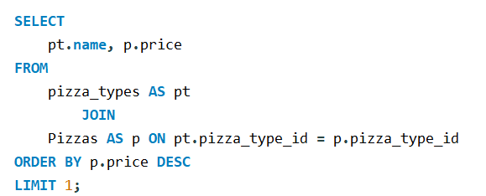
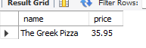
Identify the highest-priced pizza.
OUTPUT
Identify the highest-priced pizza.

Slide 6
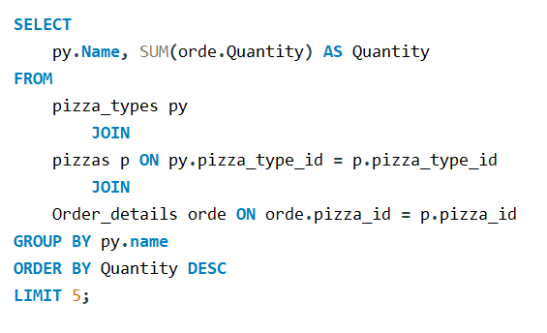
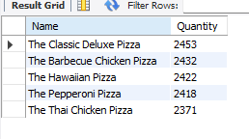
List the top 5 most ordered pizza types along with their quantities.
OUTPUT

Slide 7
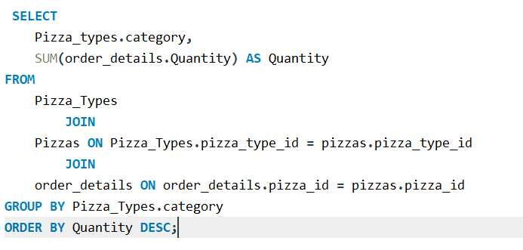
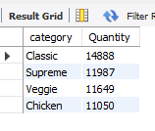
Join the necessary tables to find the total quantity of each pizza category ordered.
OUTPUT

Slide 8
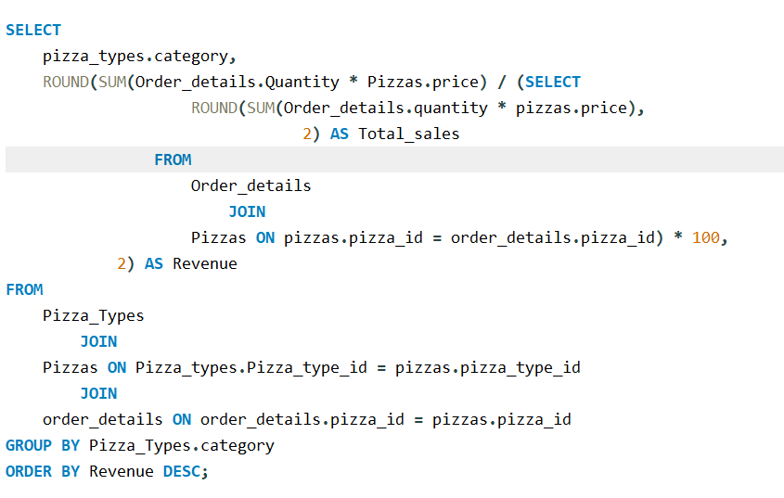
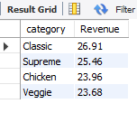
Calculate the Percentage Contribute of each Pizza type to total revenue
OUTPUT

Slide 9

THANK YOU

